Slide 1
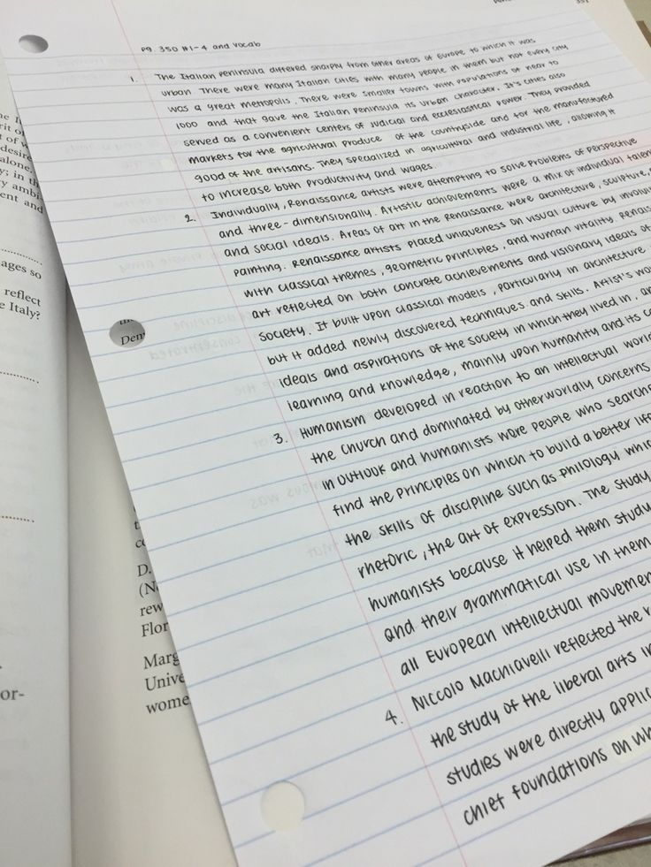
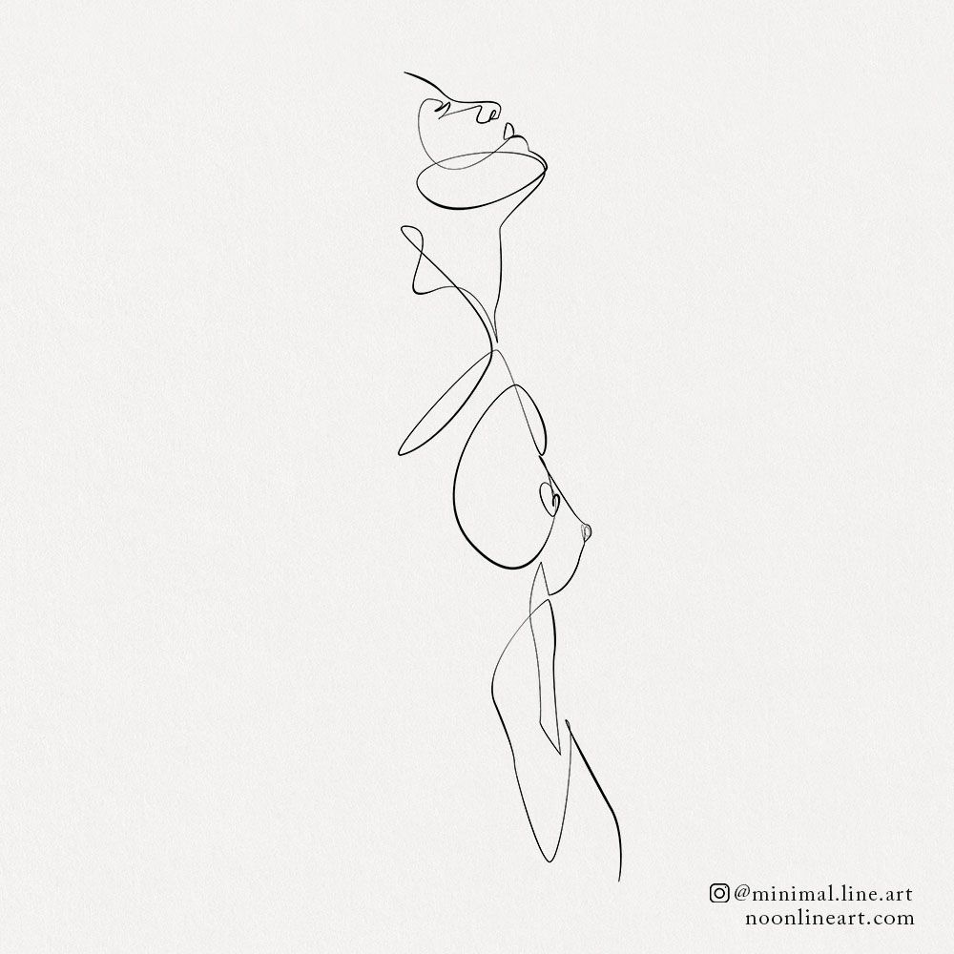

From Paper to Screen
Prototype

Slide 2
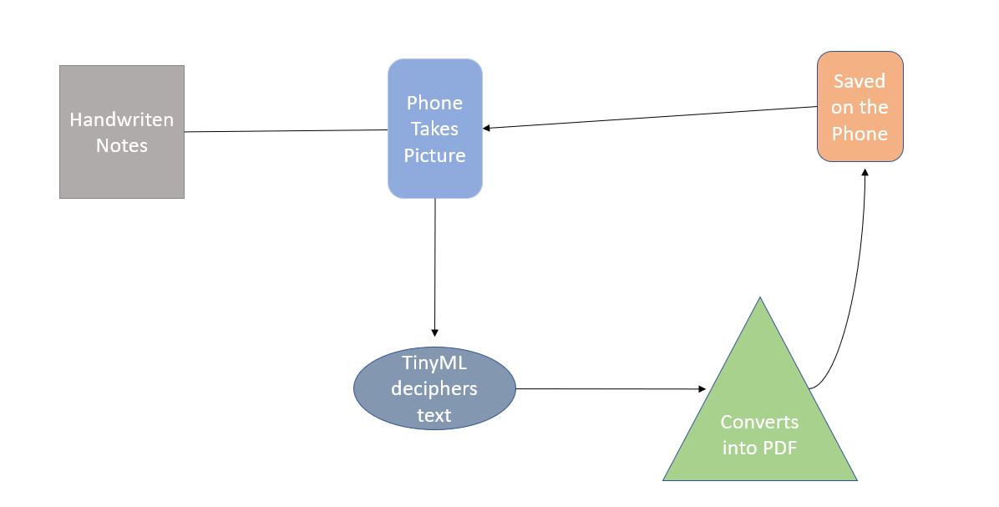
Architecture
Edge Impulse webpage on phone shows results
Handwritten notes
Phone takes pictures
TinyML Deciphers Text

Slide 3
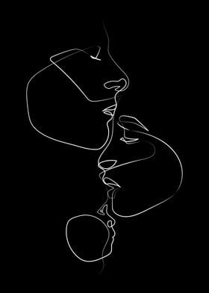
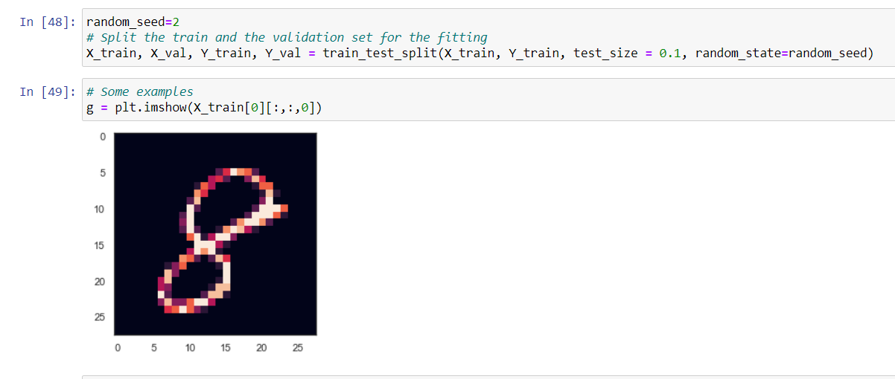
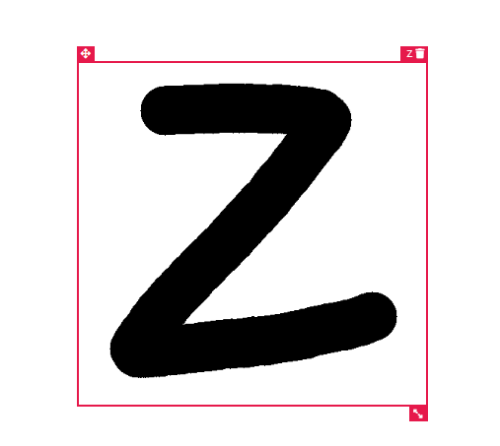
Machine Learning Technique
Using Edge Impulse
Alphabet
Fomo(Faster Objects, More Objects) Mobile NetV2
Confusion Matrix
Data: Images
Labelling Boxes
Jupyter Notebook CNN Neural Network
Numbers
Confusion Matrix
Data: CSV File
Reconstructing Images through pixels

Slide 4

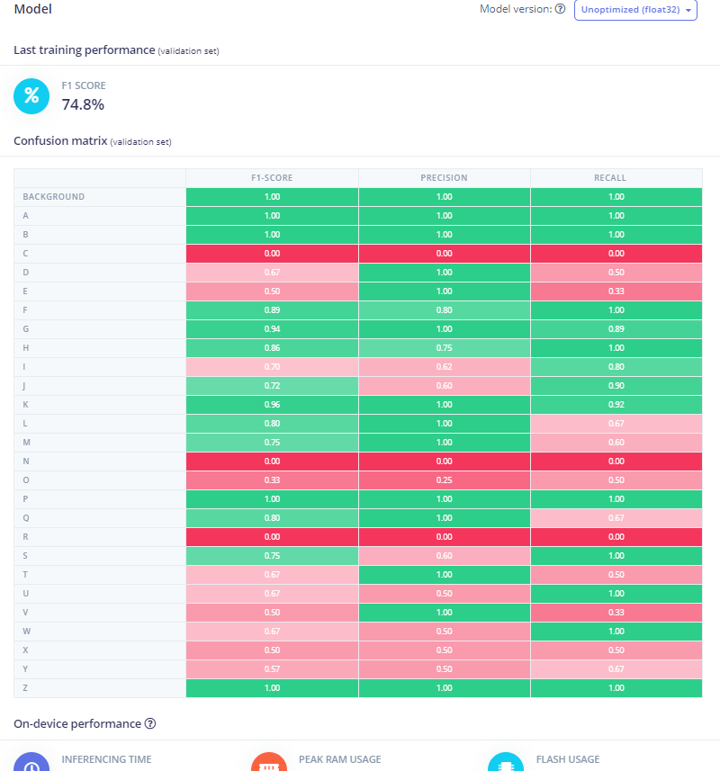
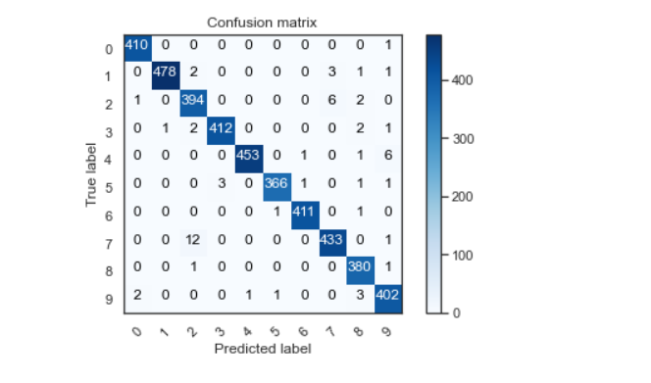
Machine Learning Technique
Using Edge Impulse
Alphabet
Performance
CNN Neural Network Python
Numbers
Performance

Slide 5
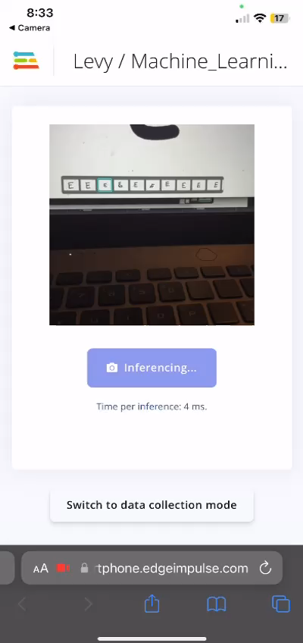
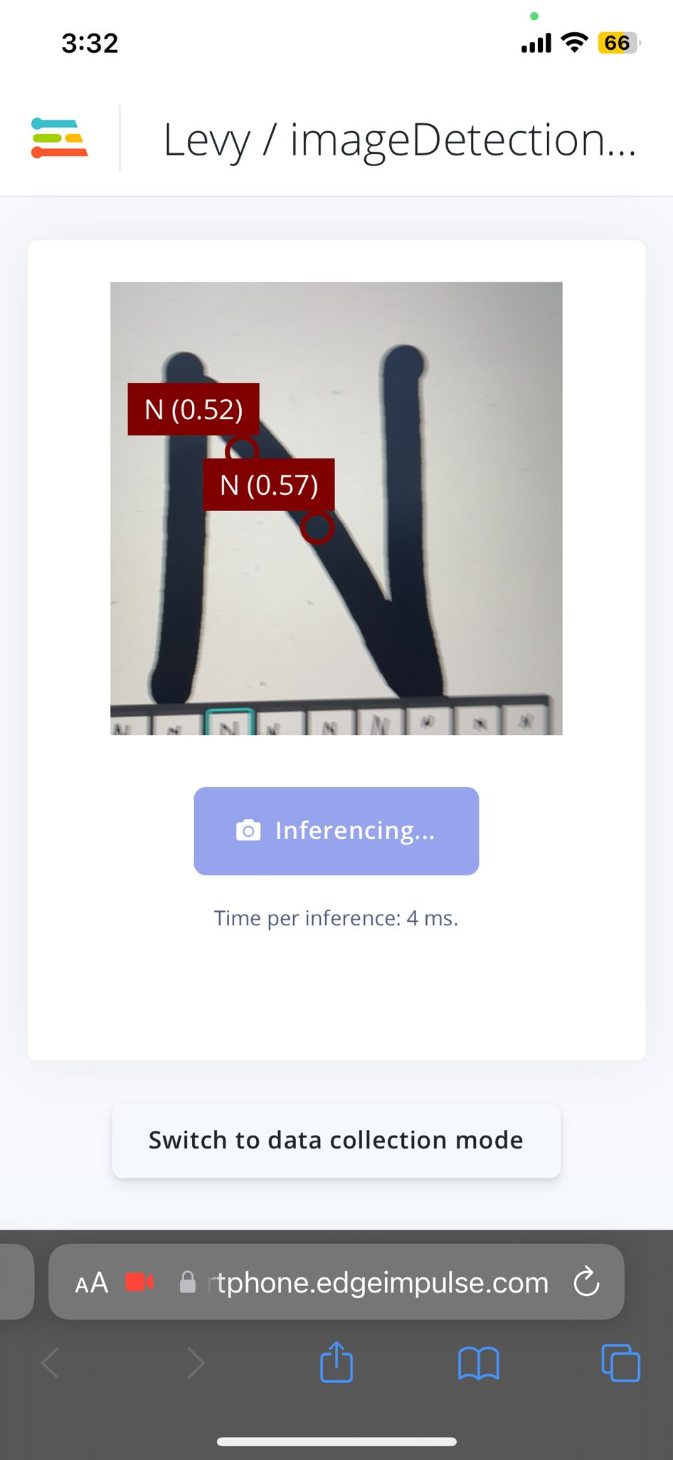
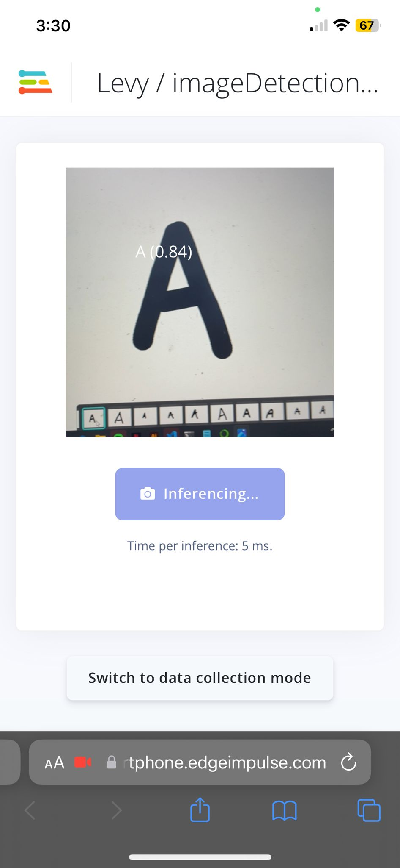
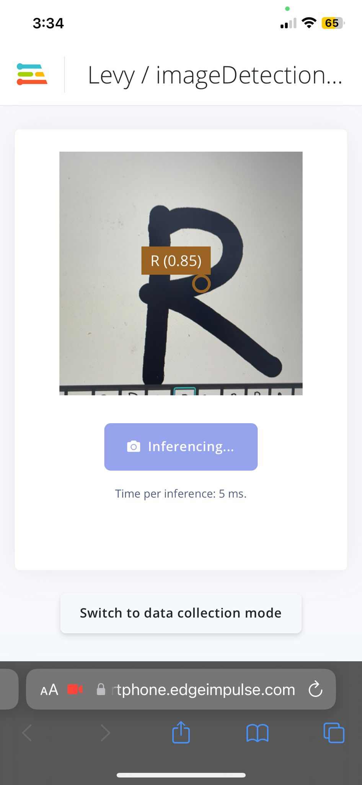
Edge Impulse Phone deployment

Slide 6
Risks, Limitations & Unexpected
Risks: The mayor risk is confusion between the 26 classes especially in the real world where Word are so close to each other
Limitations: To build a more accurate prototype I need a larger database and I was on the limit of what Edge Impulse allowed to process without paying
Unexpected: Textures, lighting and distances between objects play a major part in detecting objects
Accuracy Improvement
Uploading on neural network to Edge Impulse

Slide 7
References
Dataset: Yassineghouzam. (2017). Introduction to CNN Keras - 0.997 (top 6%). Kaggle. https://www.kaggle.com/code/yassineghouzam/introduction-to-cnn-keras-0-997-top-6/input
Dataset:The Chars74K image dataset - Character Recognition in Natural Images. (n.d.). Chars74K. Retrieved May 1, 2023, from http://www.ee.surrey.ac.uk/CVSSP/demos/chars74k/
Detect objects with bounding boxes - Edge Impulse Documentation. (n.d.). Retrieved April 16, 2023, from https://docs.edgeimpulse.com/docs/tutorials/object-detection
Building custom processing blocks - Edge Impulse Documentation. (n.d.). Retrieved April 16, 2023, from https://docs.edgeimpulse.com/docs/edge-impulse-studio/processing-blocks/custom-blocks

